Slide 1


<Joanne Tsai>
<11/04/2022>

Slide 2

Outline
Executive Summary
Introduction
Methodology
Results
Conclusion
Appendix

Slide 3
Executive Summary
Summary of methodologies
Collecting data through SpaceX API and web scraping
Exploratory Data Analysis through data visualization
Analysis the proximity of launch sites through Folium
Machine learning model building by svm, classification tree, and logistic regression
Summary of all results
Different features affect successes of launch in different ways and weight.
We got the weight of different features, and the prediction of based on new feature fed to the model.

Slide 4
Introduction
In this project, we analyze the Space X Falcon 9 data set. We aim to find out the relationship between launching features (e.g. launch site, loading mass, orbit…etc) in order to summarize the conditions that maximizes the success rate of landing.
Our goal is to use Space X Falcon 9 historical launching/landing data to predict whether Space X will attempt to land a rocket or not.

Slide 5

Section 1

Slide 6
Methodology
Executive Summary
Data collection methodology:
The data was collected through SpaceX API and web scraping from Wikipedia.
Perform data wrangling
The data was preprocessed by removing or filling missing data, removing non-relevant column, selecting needed rows…etc.
Perform exploratory data analysis (EDA) using visualization and SQL
Perform interactive visual analytics using Folium and Plotly Dash
Perform predictive analysis using classification models
Use cross validation method to tune the hyperparameters for the models.

Slide 7
Data Collection
The data set was collected from two resources.
1. making get requests to the SpaceX API to get information of launches
2. web-scraping to get the launch records of Falcon 9.

Slide 8
Data Collection – SpaceX API
Used the SpaceX REST API to extract information using identification numbers in the launch data.
Request rocket launch data from SpaceX API with according URL.
Parse the launch data using GET request.
Filter the data frame to only include Falcon 9 launchs.
https://github.com/JoanneCETsai/IBM_projects/blob/main/spaceX/jupyter-labs-spacex-data-collection-api.ipynb
our analysis system
request
SpaceX API
Internet
Database
response
From rocket column we got “booster name”
From launchpad we got “launch site”, “longitude”, “latitude”
From payload we got ”mass of payload” and “orbit”
From cores we got the “outcomes” of the landing, “type” of the landing…etc.

Slide 9
Data Collection - Scraping
Web Scrap Falcon 9 launch records with BeautifulSoup.
Request the Falcon9 Launch Wiki page from its URL
Extract all column/variable names from the HTML table header
Create a data frame by parsing the launch HTML tables
https://github.com/JoanneCETsai/IBM_projects/blob/main/spaceX/jupyter-labs-webscraping.ipynb
BeaitifulSoup
Website
(data source)
Scraping agent
Structured model

Slide 10
Data Wrangling
Perform Exploratory Data Analysis and determine Training Labels
Calculate the number of launches on each site
Calculate the number and occurrence of each orbit
Gain overview of the data set through EDA
Calculate the number and occurance of mission outcome per orbit type
Create a landing outcome label

Slide 11
EDA with Data Visualization
Scatter plot (with success landing marked with orange, failure landing marked with blue):
Flight Number vs Launch Site
Payload vs Launch Site
Flight Number vs Orbit type
Payload vs Orbit type
Bar chart: success rate of each orbit type
Line chart: launch success yearly trend
https://github.com/JoanneCETsai/IBM_projects/blob/main/spaceX/jupyter-labs-eda-dataviz.ipynb

Slide 12
EDA with SQL
Display the names of the unique launch sites in the space mission
Display 5 records where launch sites begin with the string 'CCA'
Display the total payload mass carried by boosters launched by NASA (CRS)
Display average payload mass carried by booster version F9 v1.1
List the date when the first successful landing outcome in ground pad was achieved
List the names of the boosters which have success in drone ship and have payload mass greater than 4000 but less than 6000
https://github.com/JoanneCETsai/IBM_projects/blob/main/spaceX/jupyter-labs-eda-sql-coursera.ipynb

Slide 13
Build an Interactive Map with Folium
Mark all launch sites on a map using folium.Circle() and folium.map.Marker
Mark the success/failed launches for each site on the map using MarkerCluster
Calculate the distances between a launch site to its proximities
- Use MousePossition to find the coordinates
- Use folium.PolyLine to mark lines on the map
https://github.com/JoanneCETsai/IBM_projects/blob/main/spaceX/lab_jupyter_launch_site_location.ipynb

Slide 14
Build a Dashboard with Plotly Dash
Pie Chart
By selecting the launch sites in the dropdown menu, you can see the success rate of each launch site.
If all launch sites are selected, you can see the comparison of success rate of all sites
Scatter Plot
selecting the launch site and loading mass range, you can see the payload mass vs class scatter plot
https://github.com/JoanneCETsai/IBM_projects/blob/main/spaceX/spacex_dash_app.py

Slide 15
Predictive Analysis (Classification)
Cross validation to fine the best hyperparameter
https://github.com/JoanneCETsai/IBM_projects/blob/main/spaceX/SpaceX_Machine%20Learning%20Prediction_Part_5.ipynb
Confusion matrix&
prediction score
Select features and target columns
Train test split
Train 3 different models: SVM, Classification Tree, Logistic regression
Use the test set to evaluate the model

Slide 16
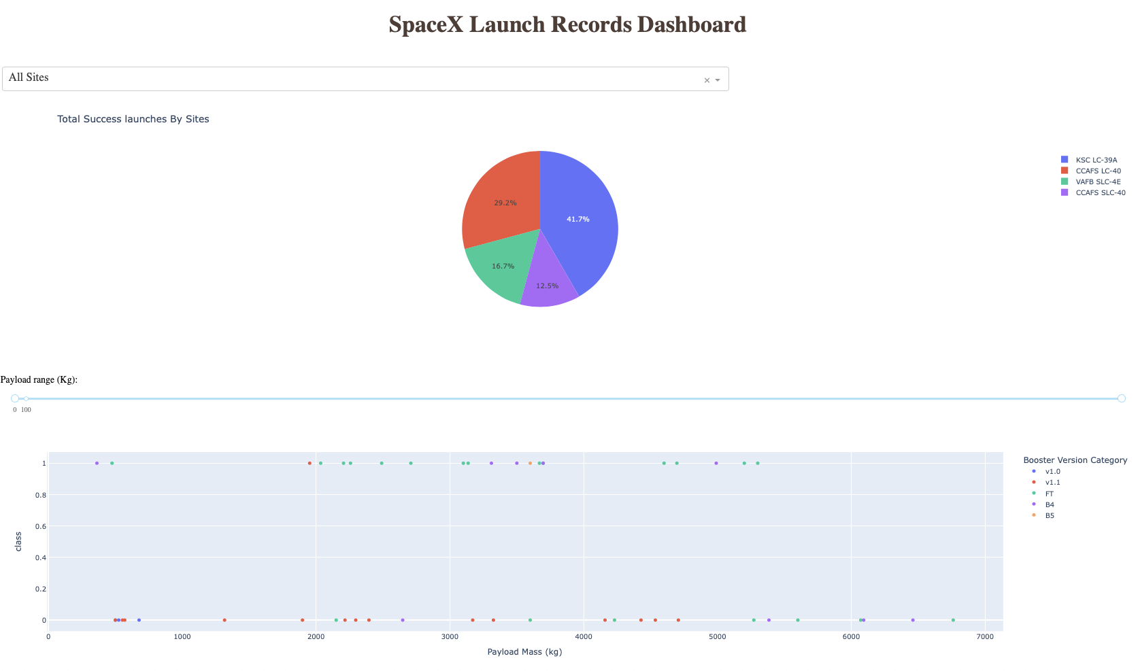
Results

Slide 17

Section 2

Slide 18
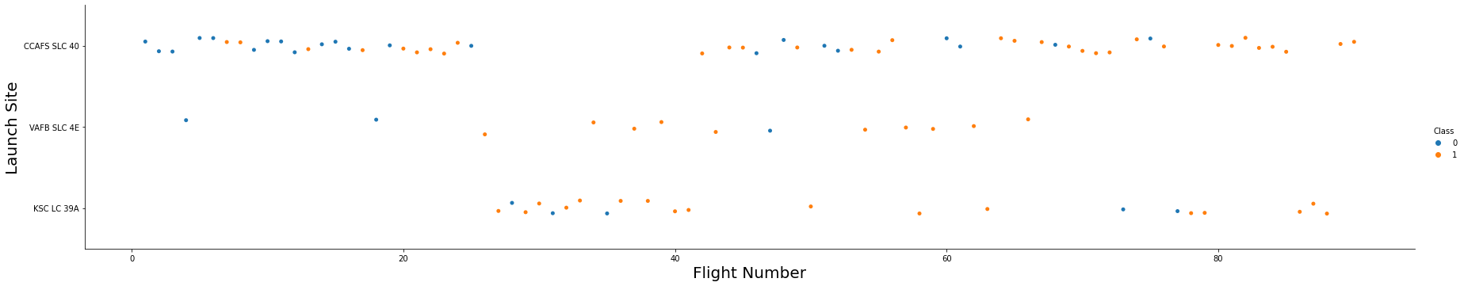
Flight Number vs. Launch Site
For all the boosters, the success rate seems increase with flight number.

Slide 19
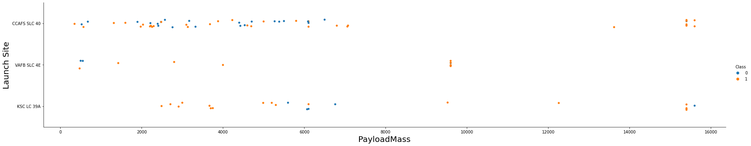
Payload vs. Launch Site
For CCAFS SLC 40 and VAFB SLC 4E, when payload mass is high, the success rate is high.
For KSC LC 39A, the relationship between success rate and payload mass is not obvious.

Slide 20
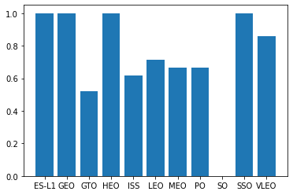
Success Rate vs. Orbit Type
GTO orbit has the lowest success rate.
ES-L1, GEO, HEO, and SSO have 100% success rate.
VLEO also has high success rate.

Slide 21
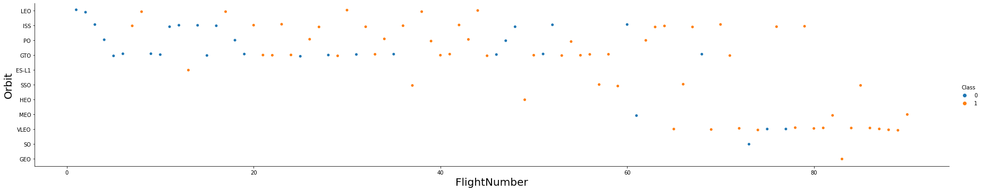
Flight Number vs. Orbit Type
In the LEO orbit the Success appears related to the number of flights; on the other hand, there seems to be no relationship between flight number when in GTO orbit.

Slide 22
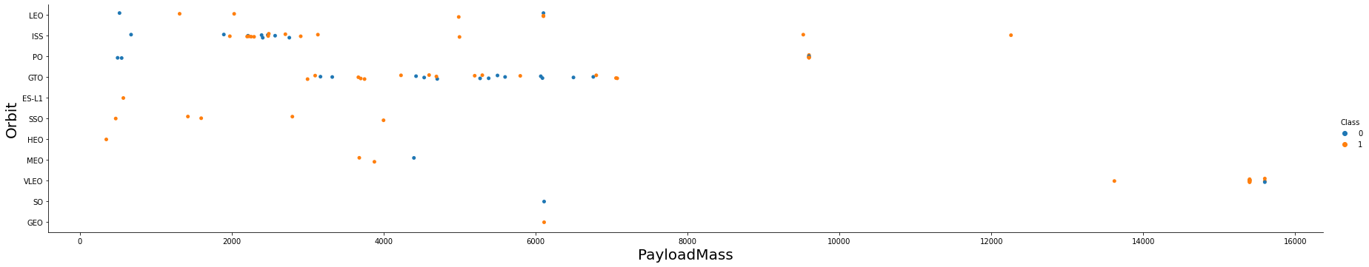
Payload vs. Orbit Type
With heavy payloads the successful landing rate are more for Polar, LEO and ISS.
For GTO, we cannot distinguish this well as both positive landing rate and negative landing(unsuccessful mission) are both there here.

Slide 23
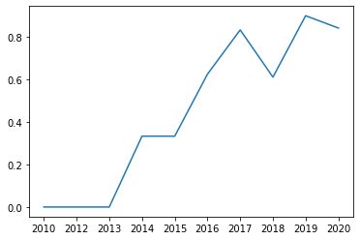
Launch Success Yearly Trend
the success rate since 2013 kept increasing, and fluctuate a bit during 2018-2020.

Slide 24
All Launch Site Names
The names of the unique launch sites:
'CCAFS LC-40', 'VAFB SLC-4E', 'KSC LC-39A', 'CCAFS SLC-40’
There are 4 different launch sites.

Slide 25
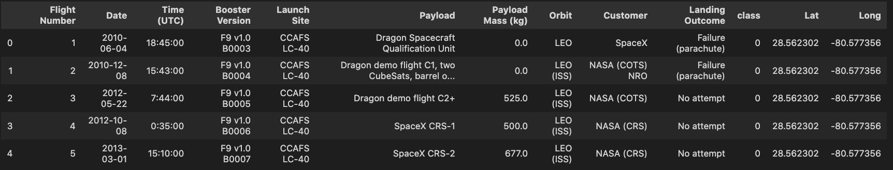
Launch Site Names Begin with 'CCA'

Slide 26
Total Payload Mass
Calculate the total payload carried by boosters from NASA
Present your query result with a short explanation here

Slide 27
Average Payload Mass by F9 v1.1
The average payload mass carried by booster version F9 v1.1 = 2928.4 kg

Slide 28
First Successful Ground Landing Date
Find the dates of the first successful landing outcome on ground pad
Present your query result with a short explanation here

Slide 29
Successful Drone Ship Landing with Payload between 4000 and 6000
List the names of boosters which have successfully landed on drone ship and had payload mass greater than 4000 but less than 6000
Present your query result with a short explanation here

Slide 30
Total Number of Successful and Failure Mission Outcomes
The total number of success : 32
The total number of failure : 24

Slide 31
Boosters Carried Maximum Payload
List the names of the booster which have carried the maximum payload mass: F9 FT B1029.1, F9 FT B1036.1, F9 B4 B1041.1, F9 FT B1036.2, and F9 B4 B1041.2

Slide 32
2015 Launch Records
List the failed landing_outcomes in drone ship, their booster versions, and launch site names for in year 2015

Slide 33
Rank Landing Outcomes Between 2010-06-04 and 2017-03-20
Rank the count of landing outcomes (such as Failure (drone ship) or Success (ground pad)) between the date 2010-06-04 and 2017-03-20, in descending order
Present your query result with a short explanation here

Slide 34

Section 3

Slide 35
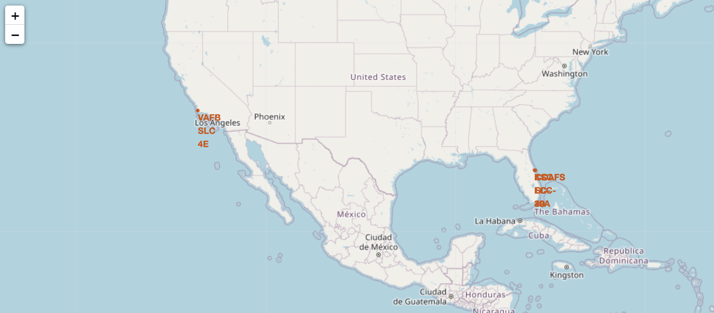
<The location of launch sites>
We can zoom in to see the location of each launch site.

Slide 36
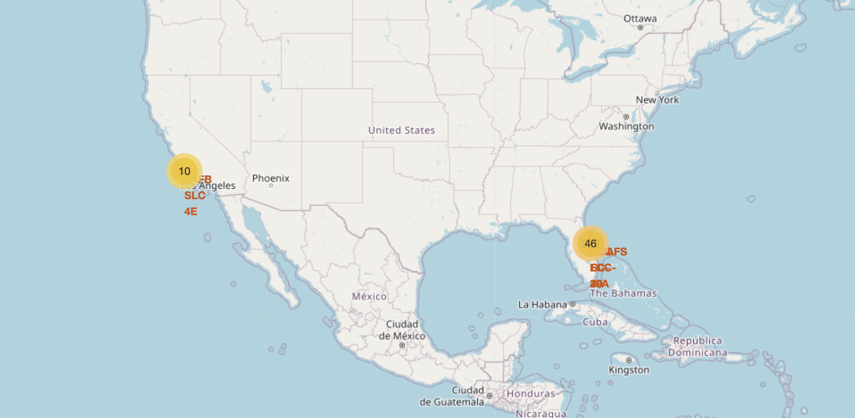
<The success/failed launches for each sites on the map>
Through this map, we can check the success and failures in each site.

Slide 37
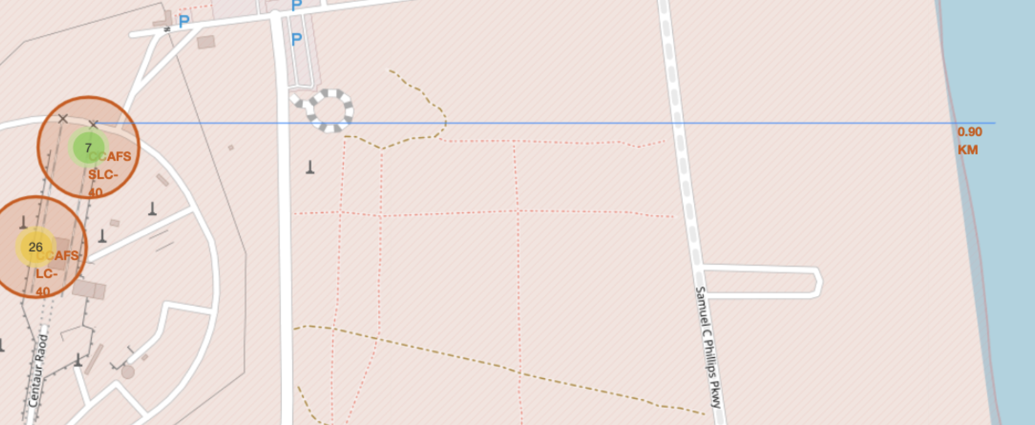
<Distance between a launch site to its proximities>
Through this part of the map, you can calculate the distance between a launch site and its proximities, eg. Rails, road, and coast.

Slide 38

Section 4

Slide 39
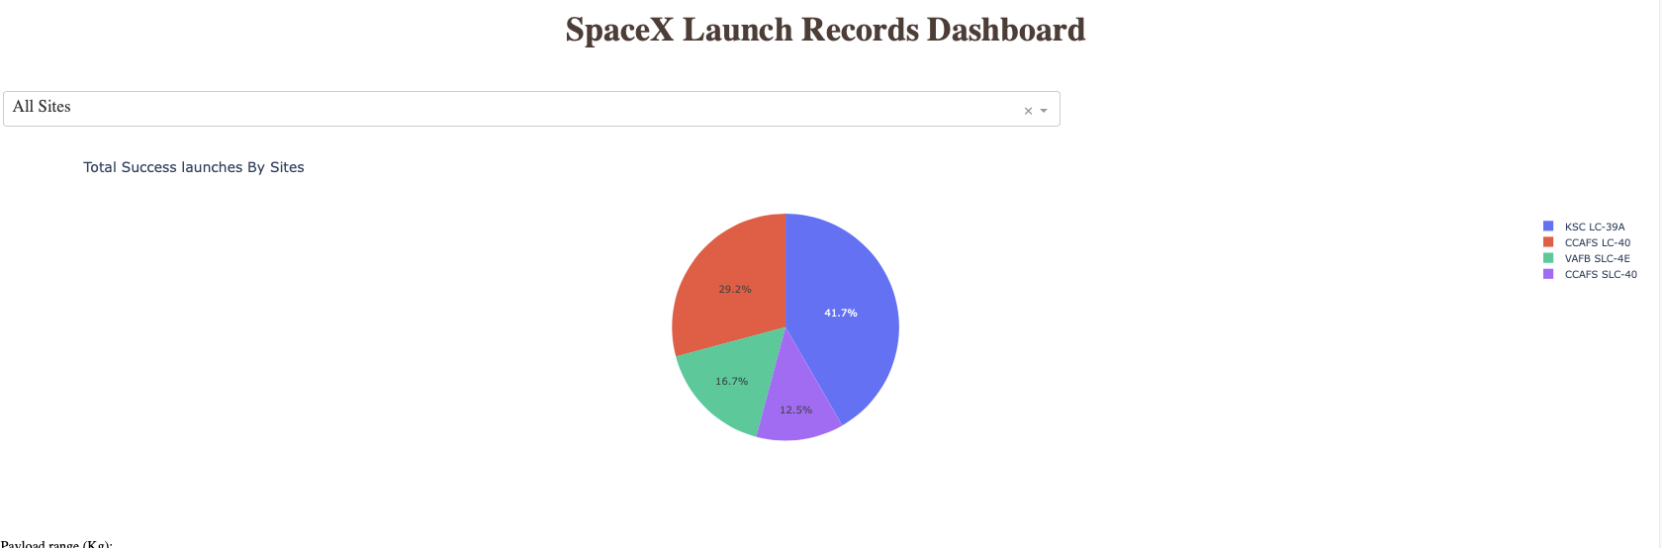
<Total success launches by sites>
Launch site KSC LC-39A has the highest success rate of landing.
Launch site CCAFS SLC-40 has the lowest success rate of landing.

Slide 40
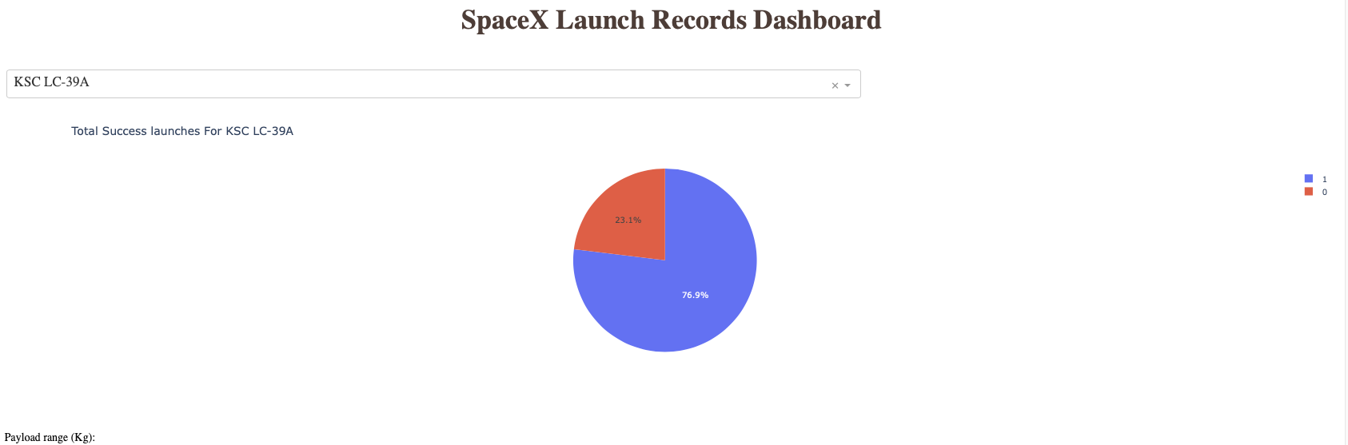
<Success rate of KSC LC-39A >
Launch site KSC LC-39A has the highest success rate of landing – 76.9%

Slide 41
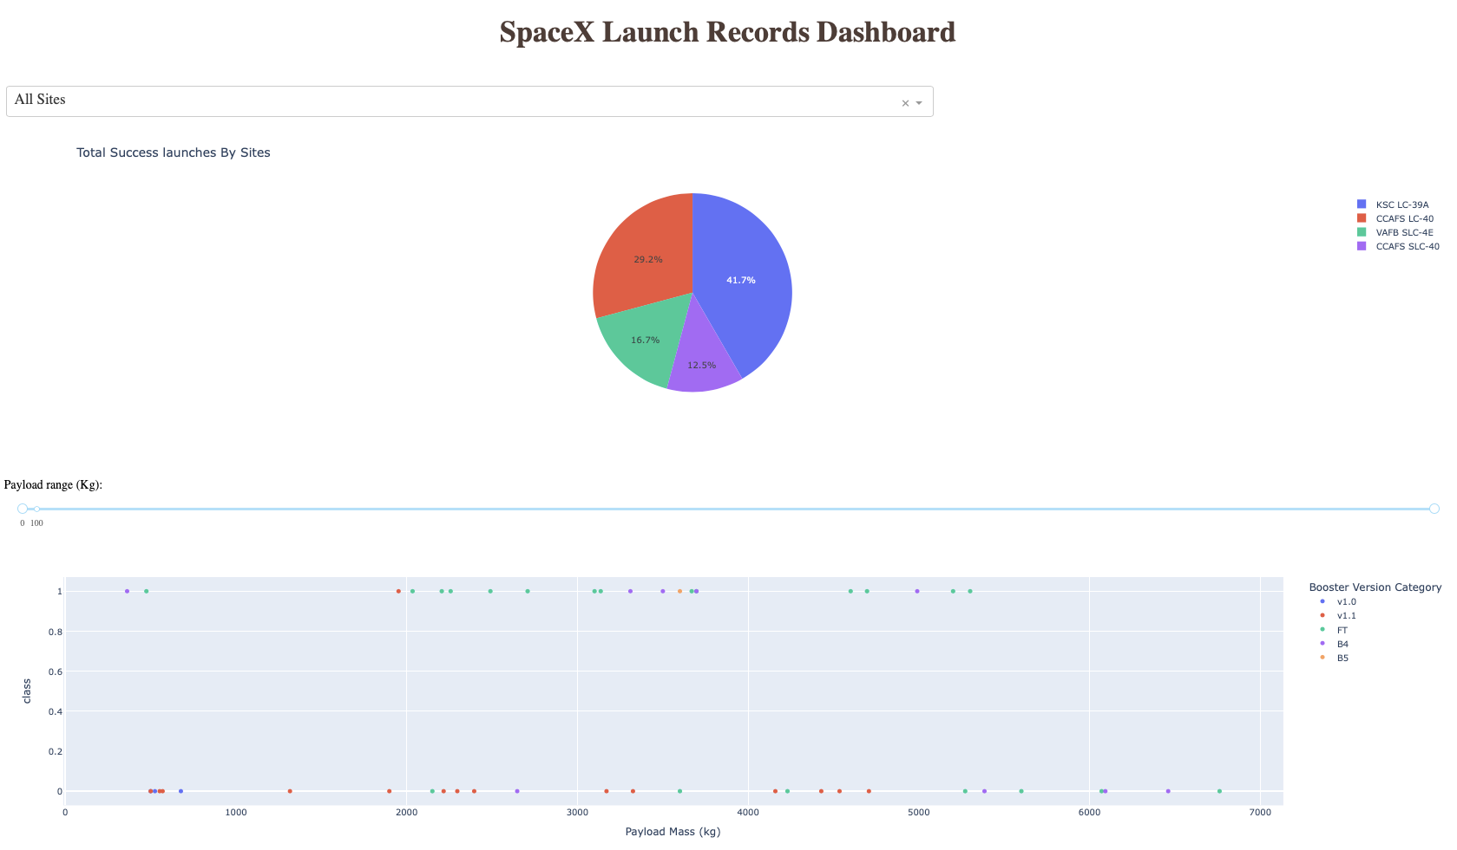
< Payload vs. Launch Outcome scatter plot for all sites >
We can select the range of payload mass and site to see the success.

Slide 42

Section 5

Slide 43
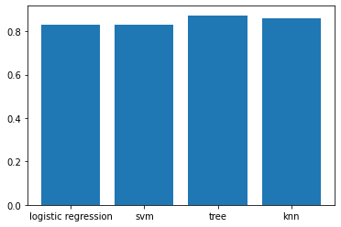
Classification Accuracy
The results showed that the decision tree classifier has the highest accuracy – 0.874

Slide 44
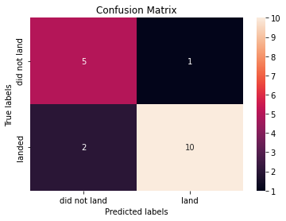
Confusion Matrix
This is the confusion matrix of decision tree classifier.
In the 18 test data point, 3 of them are mis-classified. 2 of them are false negative, 1 of them is false positive.

Slide 45
Conclusions
The logistic regression model’s accuracy is 0.83.
The svm model’s accuracy is 0.83.
The decision tree model’s accuracy is 0.874.
The KNN model’s accuracy is 0.86.
All 4 models show high accuracy, and they can predict our target well.

Slide 46
Appendix
Python code reference:
https://python-visualization.github.io/folium/
https://plotly.com/python/
https://realpython.com/python-dash/
https://plotly.com/python/plotly-express/

Slide 47


